Slide 1
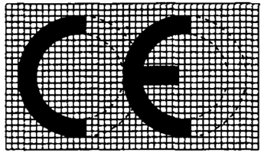
THIS SHORT PRESENTATION IS ABOUT
MARKING
WHY IT IS IMPORTANT TO BUSINESS, GOVERNMENTS AND TO INDIVIDUAL PEOPLE.
FAILURE TO TAKE ACCOUNT OF THE PROVISIONS OF CE MARKING COULD CAUSE BUSINESS FAILURE AND LEGAL CLAIMS
POSSIBLY A MATTER OF LIFE AND DEATH?
MSc in Safety Engineering - Pointers to CE Marking - January 23rd 2014
David DawsonBSc (Hons) MSc CEng MIMechE

Slide 2
FIRST … MY BRIEF BACKGROUND (CV)
GRADUATE IN MECHANICAL ENGINEERING - MANCHESTER UNIVERSITY (UMIST)
4 years with Rolls-Royce, 5 years with ICI
8 years with Lancaster and Cambridge universities running industry-based postgraduate design & manufacturing course
More recently Director of Studies @ Lancaster MSc Mechatronics Course (senior lecturer)
Many industrial consultancies and work on UK defence-related matters
Left Lancaster University in 2003 to start business developing medical devices for healing leg ulcers
MSc in Safety Engineering - Pointers to CE Marking - January 23rd 2014
David Dawson BSc (Hons) MSc CEng MIMechE

Slide 3
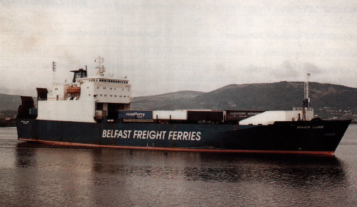
A ROLL-ON ROLL-OFF (RoRo) FERRY CARRIES ROAD TRAILERS WHICH MUST BE LASHED DOWN TO THE DECK. IF THEY MOVE AROUND AT SEA, BOTH CARGO AND SHIP ARE AT RISK
MSc in Safety Engineering - Pointers to CE Marking - January 23rd 2014
David Dawson BSc (Hons) MSc CEng MIMechE

Slide 4
RORO FERRIES CARRY A LARGE PROPORTION OF UK TRADE
SEVERAL TYPES
  PASSENGER/CARGO
  SPECIAL CARGO
  UNACCOMPANIED TRAILER
MANY SHIP CASUALTIES IN 1970’S AND 1980’S
CARGO SHIFT A SIGNIFICANT CAUSE
MSc in Safety Engineering - Pointers to CE Marking - January 23rd 2014
David Dawson BSc (Hons) MSc CEng MIMechE

Slide 5
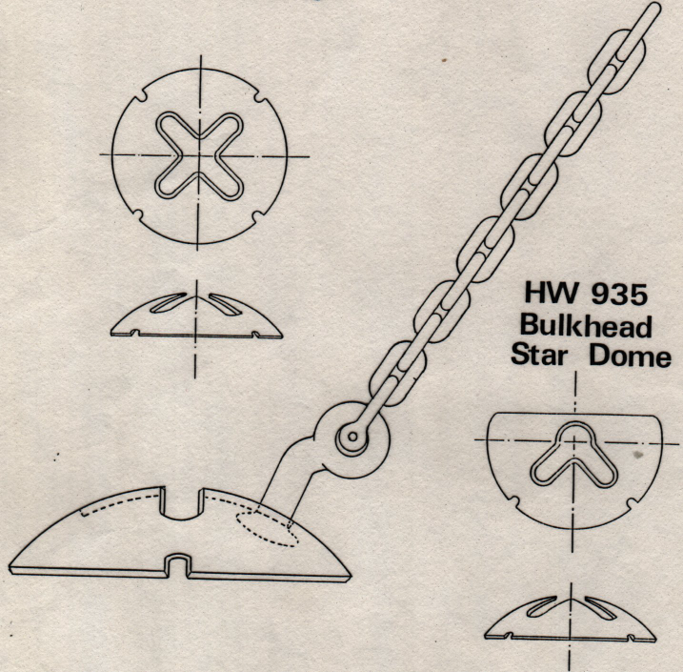
THIS IS A TYPICAL CHAIN (FIGURE SHOWS HOW IT FITS INTO AN ATTACHMENT WELDED TO THE DECK) HOW DO WE KNOW IF IT IS STRONG ENOUGH? IS IT CE MARKED?
MSc in Safety Engineering - Pointers to CE Marking - January 23rd 2014
David Dawson BSc (Hons) MSc CEng MIMechE

Slide 6
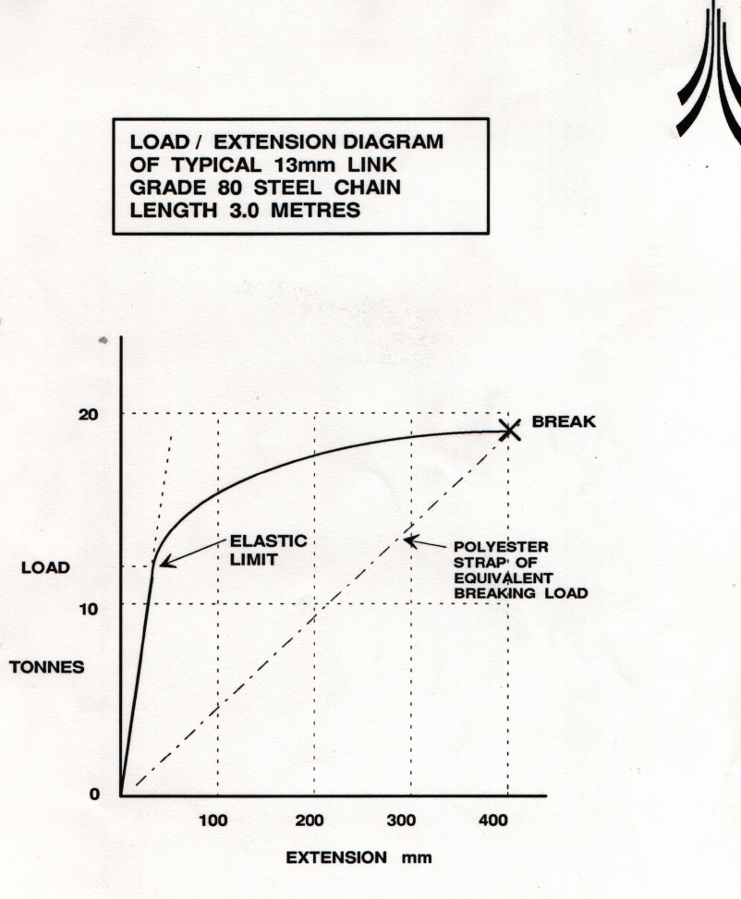
WHAT DO WE MEAN BY “STRONG” IN SIX (+) DIFFERENT LANGUAGES ?
MSc in Safety Engineering - Pointers to CE Marking - January 23rd 2014
David Dawson BSc (Hons) MSc CEng MIMechE

Slide 7
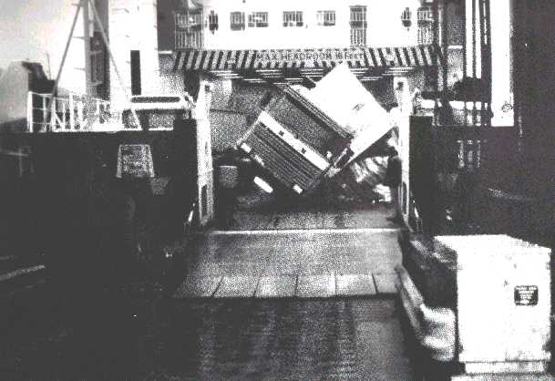
WHAT HAPPENS WHEN IT GOES WRONG !
MSc in Safety Engineering - Pointers to CE Marking - January 23rd 2014
David Dawson BSc (Hons) MSc CEng MIMechE

Slide 8
So we have CE Marking - brief history
CE Means “Conformity European” (engl)
1992 European Single Market
Aim to remove barriers to trade within EU
EU Parliament ACTS to bring together existing and future DIRECTIVES
Set out a series of NEW APPROACH DIRECTIVES intended to apply controls on PRODUCT DESIGN
MSc in Safety Engineering - Pointers to CE Marking - January 23rd 2014
David Dawson BSc (Hons) MSc CEng MIMechE

Slide 9
NEW APPROACH DIRECTIVES
started with childrens’ toys …. but quickly applied to range of engineering and related products with provisions for :-
Machinery
Electromagnetic Compatibility (EMC)
Personal Protective Equipment
Low Voltage (covers equipment from 50 to 1,000 volts)
…….. among many others
MSc in Safety Engineering - Pointers to CE Marking - January 23rd 2014
David Dawson BSc (Hons) MSc CEng MIMechE

Slide 10
Purpose of CE Marking
To ensure that products are sufficiently designed and built so that they will be fit for the purpose for which they are sold
To ensure that reasonable precautions are taken to protect the user against injury when they are being used
The effect, when applied, is that if an article has been CE marked in one member state, an importer from one EU state to another or user should have the assurance that the product conforms to standards
Questions: What about US Standards, ASME Codes etc? What is covered by Mutual Recognition Agreements - MRA’s?
MSc in Safety Engineering - Pointers to CE Marking - January 23rd 2014
David Dawson BSc (Hons) MSc CEng MIMechE

Slide 11
Directives recognise that different categories require different precautions:
e.g.
Low Voltage Directive - products designed to relevant international safety standards - independent check advised
Machinery Directive - certain categories of equipment require a mandatory third party independent check by a test house notified for the purpose by the Government
Most stringent conditions apply to such as Personal Protective Equipment - product must have independent test and conform in its manufacturing QA to ISO 9000
MSc in Safety Engineering - Pointers to CE Marking - January 23rd 2014
David Dawson BSc (Hons) MSc CEng MIMechE

Slide 12
Directives
Contain Protection and Administrative Requirements
Protection Requirements - cover safety requirements which must be met. Differ in detail - but refer to product standards which are developed by multinational committees comprised of nominated individuals under the national standards organisations of EU members
Administrative Requirements - lay down how the manufacturer (or their agent) must CE mark the product
Manufacturer must produce a DECLARATION OF CONFORMITY stating that the product meets the requirements of the directives that apply to it and the standards or other references which were used to judge that it complies
MSc in Safety Engineering - Pointers to CE Marking - January 23rd 2014
David Dawson BSc (Hons) MSc CEng MIMechE

Slide 13
What About Existing National Standards?
Many existing national standards have been covered or are being progressively covered under the system for approving in all EU countries as:-
Transposed Harmonised Standards
For example, in the case of existing British (BS) Standards, under EU approval, these can be given both a BS and EN Number
MSc in Safety Engineering - Pointers to CE Marking - January 23rd 2014
David Dawson BSc (Hons) MSc CEng MIMechE

Slide 14
Administrative Requirements normally contain:-
Requirement to produce and maintain a file of design and manufacturing information - known as the Technical File or the Technical Construction File - to assure design traceability
May lay down time limits during which such file must be kept - even after the end of a product’s market life
May involve measures to keep track of products in the market place over defined time limits
Questions:- What about modifications and upgrades?
MSc in Safety Engineering - Pointers to CE Marking - January 23rd 2014
David Dawson BSc (Hons) MSc CEng MIMechE

Slide 15
The CE Mark
Must be affixed to products covered by the Directives in order of preference :
The product (unless good technical reasons prevent)
Its instruction manual
Its packaging
Must be at least 5mm high (!!)
Indicates to the enforcement authorities that the product meets the requirements of all the Directives which apply to it.
MSc in Safety Engineering - Pointers to CE Marking - January 23rd 2014
David Dawson BSc (Hons) MSc CEng MIMechE

Slide 16
Imports into the EU
Where a manufacturer is based outside the EU it is the “person” who is responsible for bringing the equipment across the first EU border who has the responsibility for CE marking it.
Unless the Directives which apply to the product specifically require the involvement of a competent third party for product approval or quality assessment system - the manufacturer can affix the mark without having to involve a test house, consultant or DTI..
Questions: Grey areas here ! Equipment with subassemblies from many sources? How far can responsibility be delegated to a distributor or subsidiary “authorised representative”?
MSc in Safety Engineering - Pointers to CE Marking - January 23rd 2014
David Dawson BSc (Hons) MSc CEng MIMechE

Slide 17
Independent Testing
Safest way to proceed - show Due Diligence
If mandatory - must be done through but not necessarily by “Notified Body” or - organisation nominated by a member Government and Notified by the European Commission e.g BSI, LRQA.
The “Notified Body” will require to see a Type Examination Certificate from a Recognised Test House.
MSc in Safety Engineering - Pointers to CE Marking - January 23rd 2014
David Dawson BSc (Hons) MSc CEng MIMechE

Slide 18
Steps in CE marking
Identify relevant Directives
When do these Directives apply? (e.g. anticipate)
Are there relevant Harmonised EU standards?
How far does product comply with essentials - identify existing design data, test reports ..
Need for independent test of product or s/c assemblies?
Prepare Declaration of Conformity and supporting evidence
Maintain Technical Files
Check for conformity with any residual national requirements
Apply to Notified Body for approval
Apply CE Marking in accordance with Directives
MSc in Safety Engineering - Pointers to CE Marking - January 23rd 2014
David Dawson BSc (Hons) MSc CEng MIMechE

Slide 19
Typical Content of a Technical File (directives tend to give general guidance)
General Description Functions And Block Diagram
Wiring And Circuit Diagrams
General Arrangement Drawings And Parts List
List Of Standards Applied
Records Of Assessment To Standards
Description Of Control Philosophy/Logic/Datasheets And Test Certificates For Critical Sub-assemblies
Copies Of Any Markings Of Labels
Instructions (User Manuals, Maintenance, Installation)
QA Procedures
Declaration Of Conformity
MSc in Safety Engineering - Pointers to CE Marking - January 23rd 2014
David Dawson BSc (Hons) MSc CEng MIMechE

Slide 20
Additional Content of a Technical File …..
May include more … but not packed or padded !
Show how the equipment operates and how it meets the safety objectives of the Directive
Is not a public document - only the authorities given powers to enforce the directives have the right to see the Technical File - does not need to be given to customers - and is supposed to be kept on EU soil (!)
Questions: How about software ?
MSc in Safety Engineering - Pointers to CE Marking - January 23rd 2014 David Dawson BSc (Hons) MSc CEng MIMechE

Slide 21
The act of fixing the CE Mark and signing the Declaration of Conformity is a statement by the Manufacturer that the product meets the requirements of all the Directives which apply to it
Must be true !!!
Marking a product which is not fully in accordance with the requirements of applicable directives is an offence in its own right, and will contravene consumer safety and trades descriptions legislation - normal UK fine tariff £5,000 or 3 months in jail
But above penalties are minor in comparison with potential damages in a civil action for injury where false claims have been made
MSc in Safety Engineering - Pointers to CE Marking - January 23rd 2014
David Dawson BSc (Hons) MSc CEng MIMechE

Slide 22
Signature on a Declaration of Conformity is a Binding Declaration
Statutory Bodies, Individuals and their Legal Agents will Apply the
“WARM BODY PRINCIPLE”
…someone to grab and sue or otherwise punish
Some useful contacts and web sites (exist in profusion, both government and bodies seeking to sell consultancy) HSE, DTI, BSI, … and info exchanges such as
www.engineering talk.co.uk/indexes/resources-cemark.html
www.compliance-club/archive1/
MSc in Safety Engineering - Pointers to CE Marking - January 23rd 2014
David Dawson BSc (Hons) MSc CEng MIMechE

Slide 23
EXERCISE OVER COFFEE, BEER, CURRY &c:-
EXAMINE CAREFULLY AN ELECTRIC TOASTER IN YOUR RESIDENCE (BUT DO NOT TAKE IT APART !)
MAKE INDIVIDUAL NOTES TO ANSWER THE FOLLOWING QUESTIONS and DISCUSS:
1. What controls does the toaster have?
2. What is its operating voltage?
3. Who is the manufacturer?
4. Where is it made?
5. What is the model and serial number?
…. Continued on next slide
MSc in Safety Engineering - Pointers to CE Marking - January 23rd 2014 David Dawson BSc (Hons) MSc CEng MIMechE

Slide 24
6. Is there a CE mark - where is it?
7. If you were writing the owner’s manual for this toaster, what warnings would you include to assure safe operation by the user?
8. If, as a manufacturer of electrical goods, you wanted to export a toaster to the EU from China, Malaysia, Brazil, Philipines ….outline the procedure you would undertake to ensure it could be legally imported into the UK.
Re: 7. Beware French visitors staying in your home…. who don’t possess toasters themselves!!
MSc in Safety Engineering - Pointers to CE Marking - January 23rd 2014
David Dawson BSc (Hons) MSc CEng MIMechE

